Slide 1
SCALING RELATIONS
FOR SHOCK WAVE EFFECTS
FROM IMPACTS OF COSMIC OBJECTS
WITH DIAMETER FROM A FEW METERS TO 3KM
www.AsteroidHazard.pro
Glazachev D.O., Podobnaya E.D., Popova O.P., Svetsov V.V., Shuvalov V.V. and Artemieva N.A.
glazachevd@gmail.com
IDG RAS

Slide 2
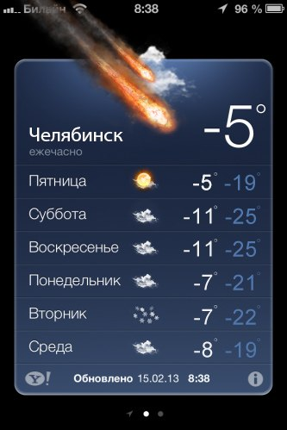
Motivation
$$\frac{Physical process}{\begin{aligned}impossible for a \\ laboratory experiment\end{aligned}}→\frac{Modeling}{slow calc}→\frac{Scaling relations }{quick calc}→\frac{online calculator}{easy to use}=Profit!$$
Notes:
The main aim is develop the tool which will be easy to use and will give a good quick estimate for all dangerous effects from large meteoroids
We are not able to organize scientific research of the physical process in a laboratory
And numerical modelling are hard to perform, it is very slow and require high computer powers
On the other hand, scaling relations are quick and much more easier to perform
Add to this, feature of easy using you get an excellent tool for many categories of people
for example, weather forecast with meteoroid danger in your iphone

Slide 3
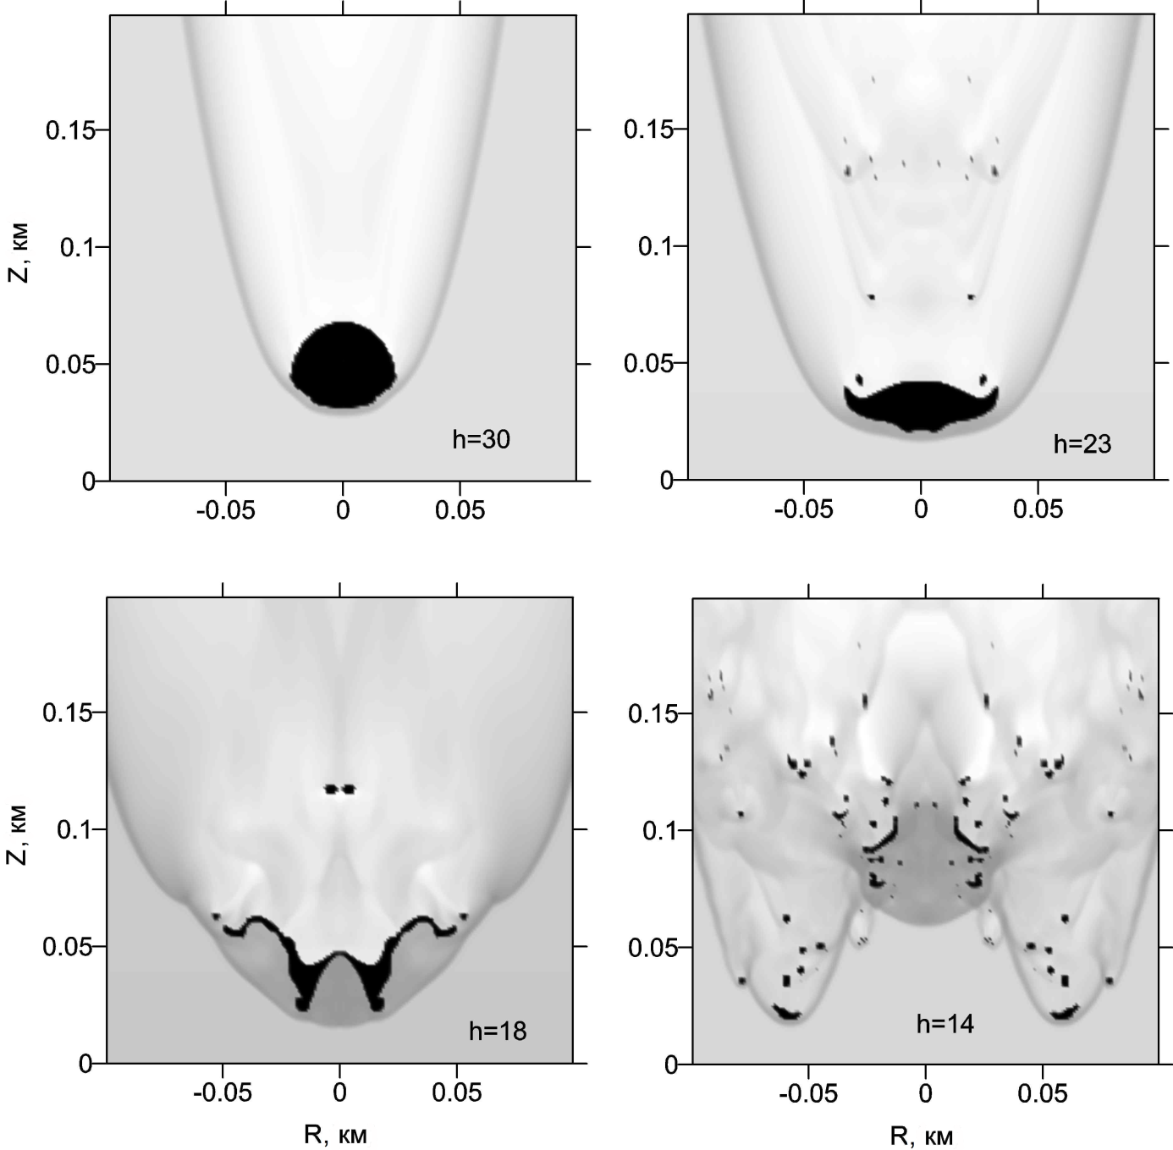
Quasi-liquid meteoroid model
Basis:
large meteoroid deformation begins at H, where aerodynamical loading>>strength
Main assumptions
Zero strength
Ablation as evaporation
Radiation transfer in thermal conductivity approximation
Formal range
D>30-50 m; H<40 km (Svettsov et al. 1993)
Restrictions:
quasi-liquid assumption
( no strength, separated fragments formation are not taken into account)
Relative density distribution along trajectory at different altitudes H
D=40 m, V=18 km/s; chondritic material (2650 kg/m³), α=90⁰
Black – solid meteoroid material
Quasi-liquid model= QL model
Notes:
Шкала? Закраска цвет
Приближение лучистой теплопроводности
Our approach is based on quasi-liquid model of meteoroid interaction with Earth's atmosphere
Great respect for colleagues doing it

Slide 4
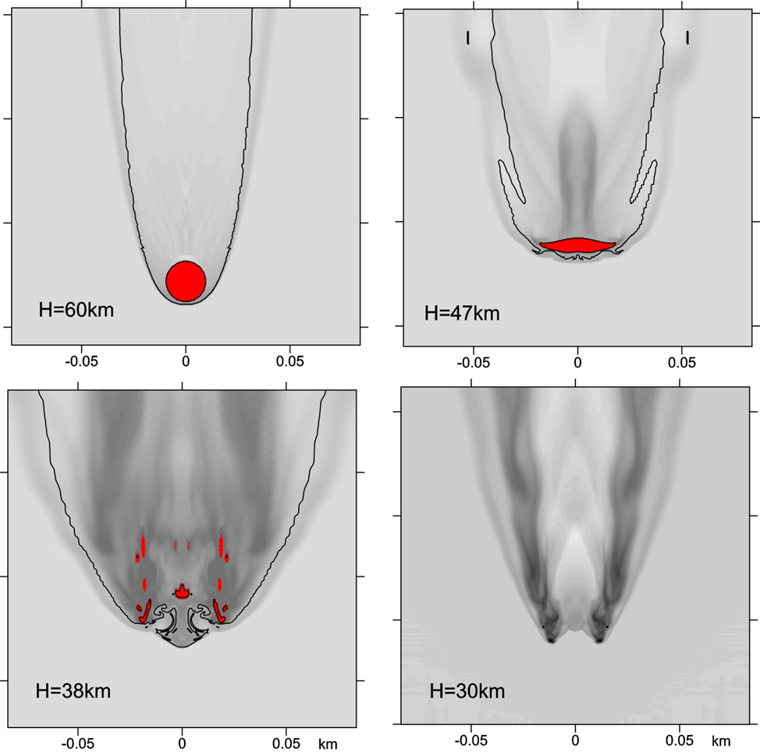
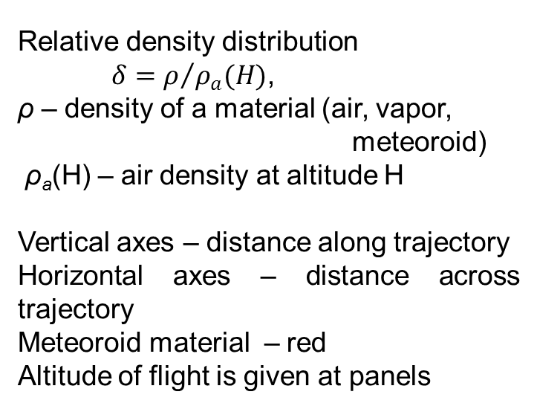
Quasi-liquid model for Chelyabinsk – like body
Chondritic meteoroid
D=19 m,
V=19 km/s
ρ=3.32 g/cm³
entry angle - 18.5 degrees
Relative density distribution
$δ=ρ/{ρ_{a}(H)}$,
ρ – density of a material (air, vapor, meteoroid)
ρ_{a}(H) – air density at altitude H
Vertical axes – distance along trajectory
Horizontal axes – distance across trajectory
Meteoroid material – red
Altitude of flight is given at panels
Notes:
This model was applied to the Chelyabinsk meteoroid
For the its parameters/ diameter is nineteen meters
And Chondrite density
and you can see some pictures of process

Slide 5
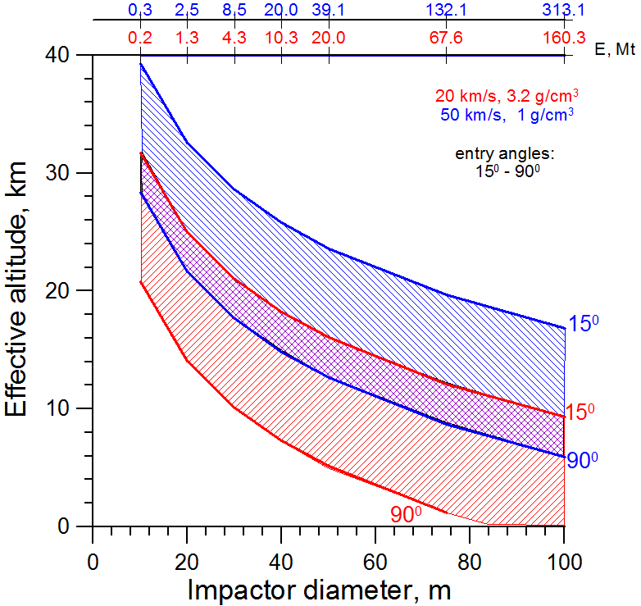
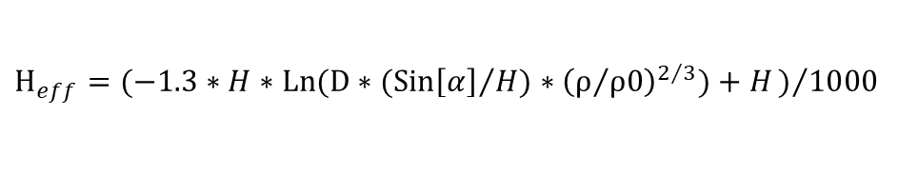
Effective airburst altitude
For quick rough evaluation of the impact consequences
(levels of damage, area of the damage, etc)
at large distances from the ground zero
spherical source - reasonable SW evaluation
if the altitude Heff of E-equivalent point explosion is correctly determined
QL model was used to determine Heff =f(D,density,α) (Shuvalov et al. 2016)
Red – asteroids;
Blue – comets;
This approach:
Precision of estimates - 2-3 km
(random character of disruption)
Is applicable for D>10-30 m when strength and fragmentation features are not essential
for D~10-30 m the uncertainty in effective altitude may reach 10-15 km (Chelyabinsk, TC₃2008 and other cases)
(strength, fragmentation features etc)
Effective altitude dependence on meteoroid size
Determination of the height of the “meteoric explosion”
Shuvalov et al. Solar System Research 2016, V.50, I.1, pp 1-12
$$H_{eff}=(−1.3∗H∗Ln(D∗({Sin\left[α\right]}/H)∗{\left(ρ/{ρ0}\right)}^{2/3})+H)/{1000}$$
Notes:
Чем меньше размер – тем выше торможение
Чем выше торможение – тем выше эффективная высота
Это старт – однороная модель
Дальше будет неоднородная
Chel-liquid-1.pptx
Zero-order approximation is point source at the some height called effective altitude
H=7500 m – characteristically height of the atmosphere
The red colors for asteroids and blue for comets
Here is shown the dependence on the diameter

Slide 6
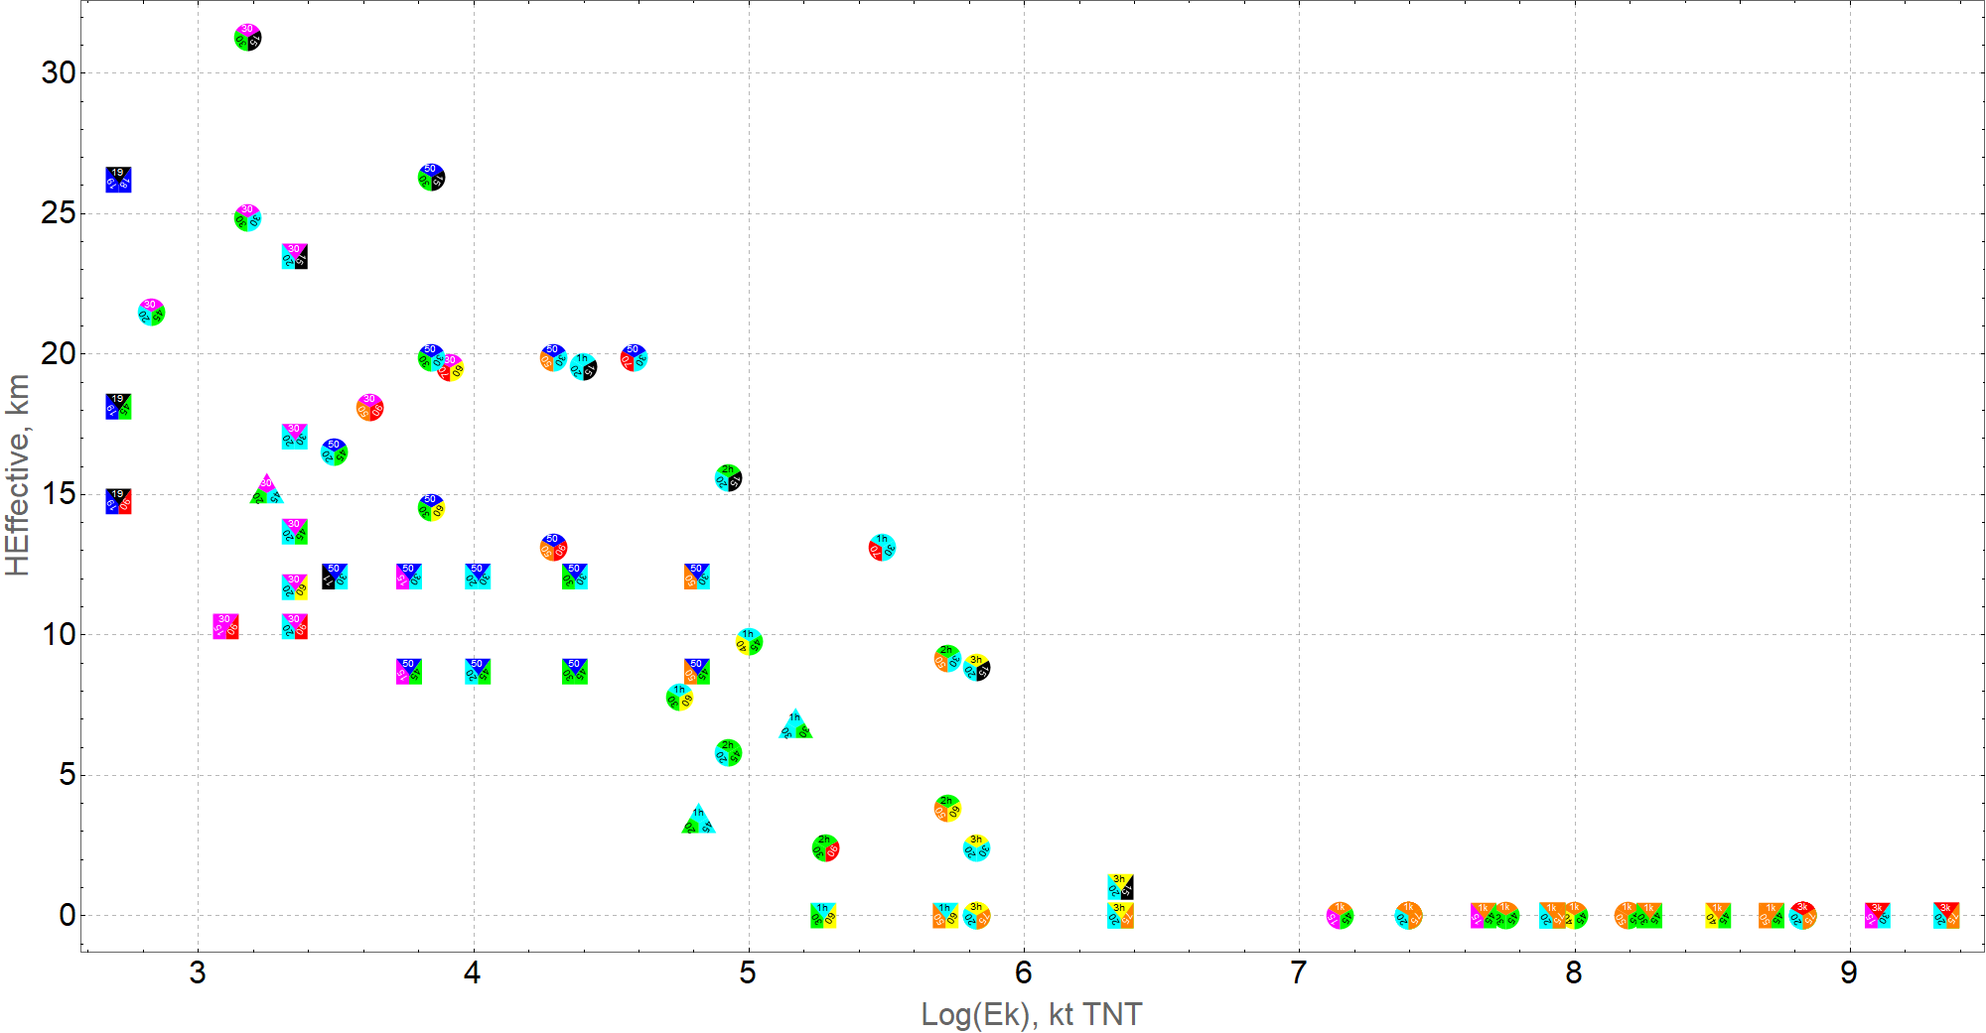
Modeled variants
Square figures – asteroids (3320 kg/m³)
Triangle figures – granite (2630 kg/m³)
Circle figures – comets (1000 kg/m³)
Total 82 variants of different diameter, fall angle, velocity and density
Notes:
At the moment we have 39 calculated variants
This is distribution of all variants by its energy and its effective altitude
This altitude is used as zero order for point source.
After that we take into account the spatial heterogeneity

Slide 7
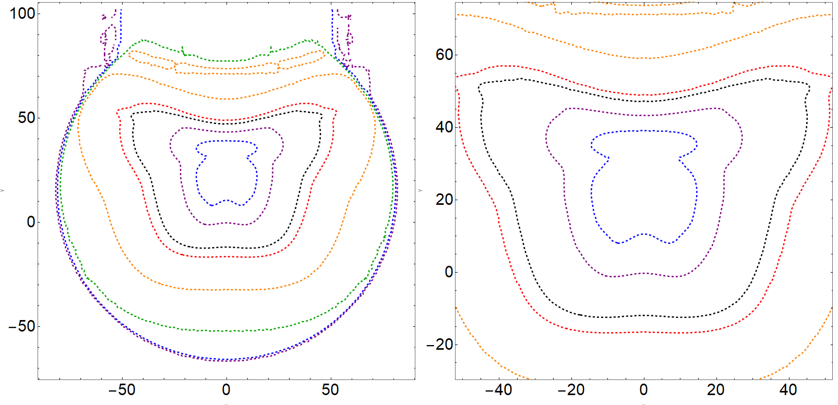

D-30-45-20
density: 3320 kg/m³
diameter: 30 m
fall angle: 45°
velocity: 20 km/s
km
km
Pressure, atm
km
km
Notes:
This is one of our variants. It is asteroid with diameter of 30 meters
You can see butterfly-like contours

Slide 8
Overpressure thresholds
Overpressure p-p0 | Effects
0.005 or 500 Pa | Glass damage
0.048 or 4.8 kPa | Minor damage to house structures
0.069 or 6.9 kPa | Partial demolition of houses, made uninhabitable
0.138 or 13.8 kPa | Partial collapse of walls and roofs of houses
0.27 or 27 kPa | Wood frame buildings will almost completely collapse
Gi N., Brown P., Aftosmis M. The frequency of window damage caused by bolide airbursts: A quarter century case study. MAPS Volume53, Issue7, 2018
Mannan, S. and Lees, F.P., Lee’s Loss Prevention in the Process Industries, Vol. 1: Hazard Identification, Assessment, and Control, Amsterdam: Elsevier, 2005, 3rd ed.
Glasstone, S. and Dolan, P.J., The Effects of Nuclear Weapons, Washington, DC: U.S. Dep. Defense, Dep. Energy, 1977.
Notes:
We continue to collect different overpressure thresholds for different effects
This is a small part of it
Of course, these thresholds depend on many parameters

Slide 9
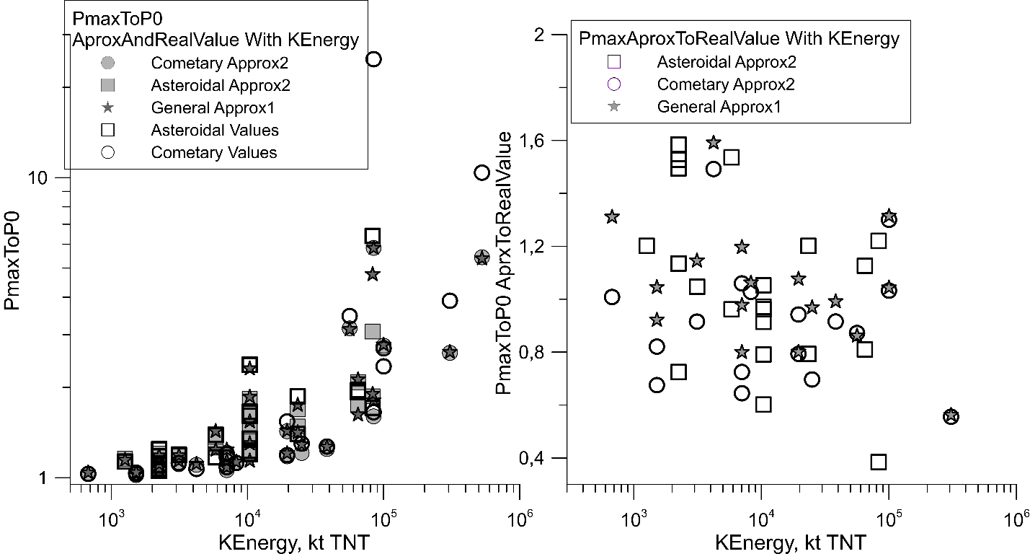
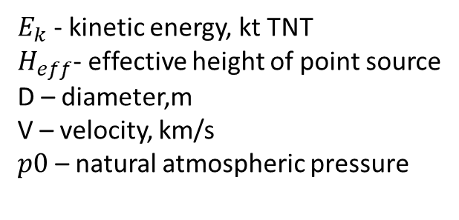
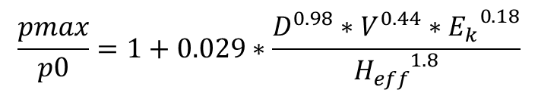
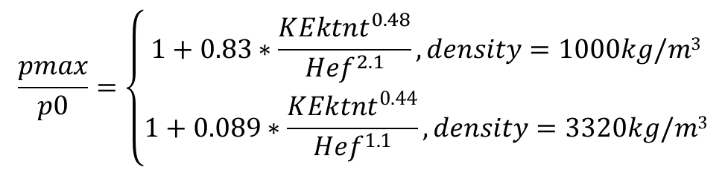
Scaling relation for overpressure maximum
$$\frac{pmax}{p0}=\left\{\begin{aligned}1+0.83∗\frac{{KEktnt}^{0.48}}{{Hef}^{2.1}}, density=1000kg/m3 \\ 1+0.089∗\frac{{KEktnt}^{0.44}}{{Hef}^{1.1}}, density=3320kg/m3\end{aligned}\right.$$
$$\frac{pmax}{p0}=1+0.029∗\frac{D^{0.98}∗V^{0.44}∗{E_{k}}^{0.18}}{{H_{eff}}^{1.8}}$$
General Approx
Approx 2
$E_{k}$ - kinetic energy, kt TNT
$H_{eff}$- effective height of point source
D – diameter,m
V – velocity, km/s
$p0$ – natural atmospheric pressure
As we can see from right pictures on fig. relative error of the general approximation is less than an error for an approximation depending on density. However, both approximations have an accuracy about 2 times.
Left: Values and two different approximations of relative maximal pressure without atmospheric influence. Right: Relative error counted as a ratio of overpressures for two different approximations.

Slide 10
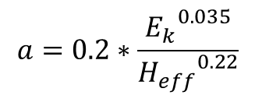
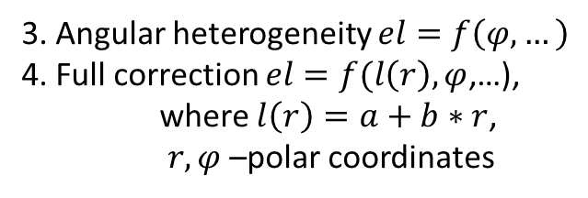
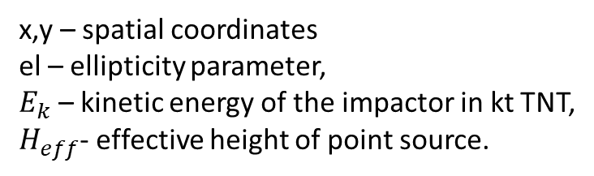
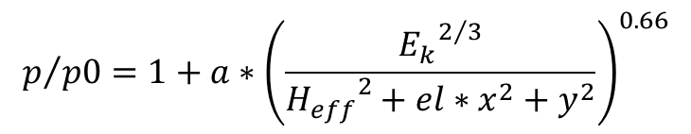
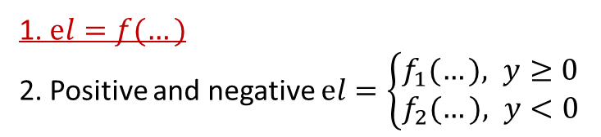

Scaling relation for overpressure for airbursts
$$p/{p0}=1+a∗{\left(\frac{{E_{k}}^{2/3}}{{H_{eff}}^{2}+el∗x^{2}+y^{2}}\right)}^{0.66}$$
$$a=0.2∗\frac{{E_{k}}^{0.035}}{{H_{eff}}^{0.22}}$$
x,y – spatial coordinates
el – ellipticity parameter,
$E_{k}$ – kinetic energy of the impactor in kt TNT,
$H_{eff}$- effective height of point source.
$$\left.el=1−0.02∗{H_{eff}}^{1.16}∗{\left.Cos[α\right]}^{2.7}{Log[E}_{k}\right]$$
The spatial heterogeneity
1. $el=f(…)$
2. Positive and negative $el=\left\{\begin{aligned}f_{1}(…), y≥0 \\ &f_{2}(…), y<0\end{aligned}\right.$
3. Angular heterogeneity $el=f\left(φ,…\right)$
4. Full correction $el=f(l\left(r\right), φ$,…),
where $l\left(r\right)=a+b∗r$,
$r,φ$ –polar coordinates
“…” – replaces impact parameters – diameter, fall angle, velocity, density, kinetic energy

Slide 11
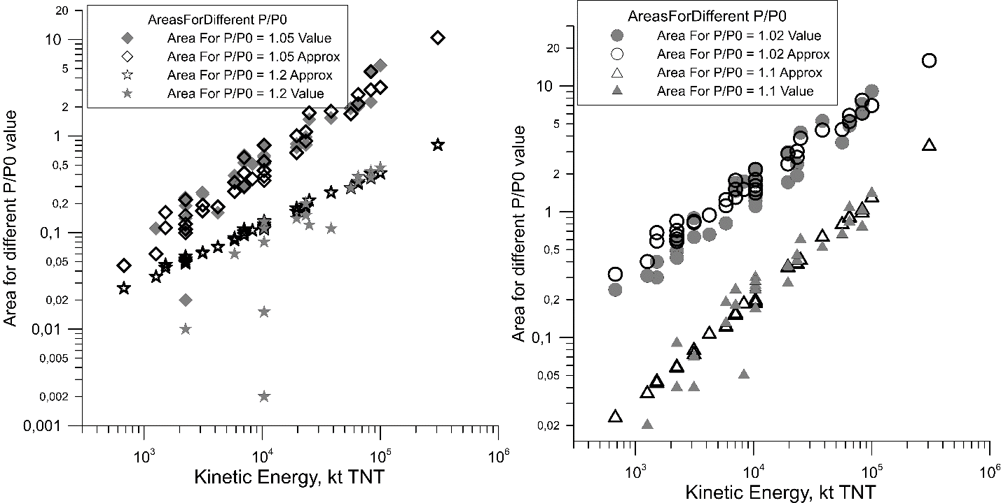
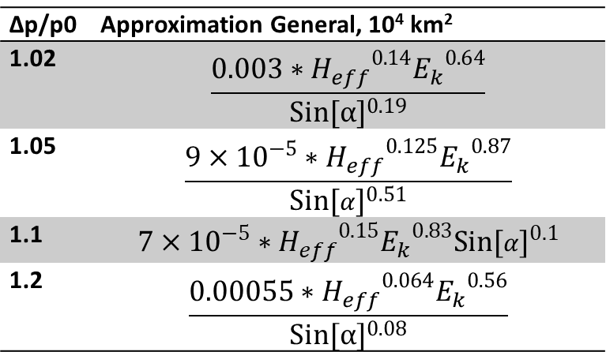
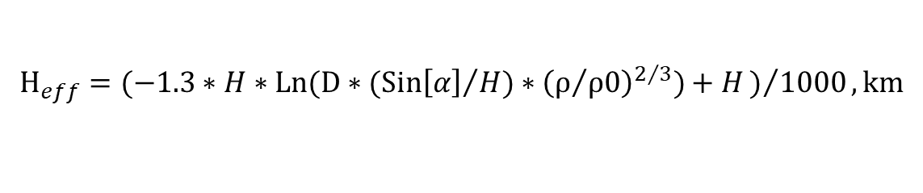
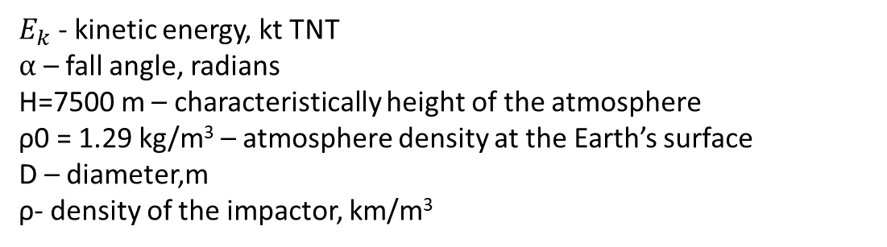
Areas of different
overpressure levels
A distribution of areas values and approximations (in 10⁴ km²) at different levels of relative overpressure.
One symbol indicates one level, empty symbols for approximations and filled – for values
∆p/p0 | Approximation General, 10⁴ km²
1.02 | $$\frac{0.003∗{H_{eff}}^{0.14}{E_{k}}^{0.64}}{{Sin[α]}^{0.19}}$$
1.05 | $$\frac{9×{10}^{−5}∗{H_{eff}}^{0.125}{E_{k}}^{0.87}}{{Sin[α]}^{0.51}}$$
1.1 | $$7×{10}^{−5}∗{H_{eff}}^{0.15}{E_{k}}^{0.83}{Sin[α]}^{0.1}$$
1.2 | $$\frac{0.00055∗{H_{eff}}^{0.064}{E_{k}}^{0.56}}{{Sin[α]}^{0.08}}$$
$$H_{eff}=(−1.3∗H∗Ln(D∗({Sin\left[α\right]}/H)∗{\left(ρ/{ρ0}\right)}^{2/3})+H)/{1000}, km$$
$E_{k}$ - kinetic energy, kt TNT
$α$ – fall angle, radians
H=7500 m – characteristically height of the atmosphere
ρ0 = 1.29 kg/m³ – atmosphere density at the Earth’s surface
D – diameter,m
ρ- density of the impactor, km/m³
Determination of the height of the “meteoric explosion”
Shuvalov et al. Solar System Research 2016, V.50, I.1, pp 1-12
Notes:
We have contours with some levels
We find some scaling relations for areas at which some levels of overpressure is exceeded.

Slide 12
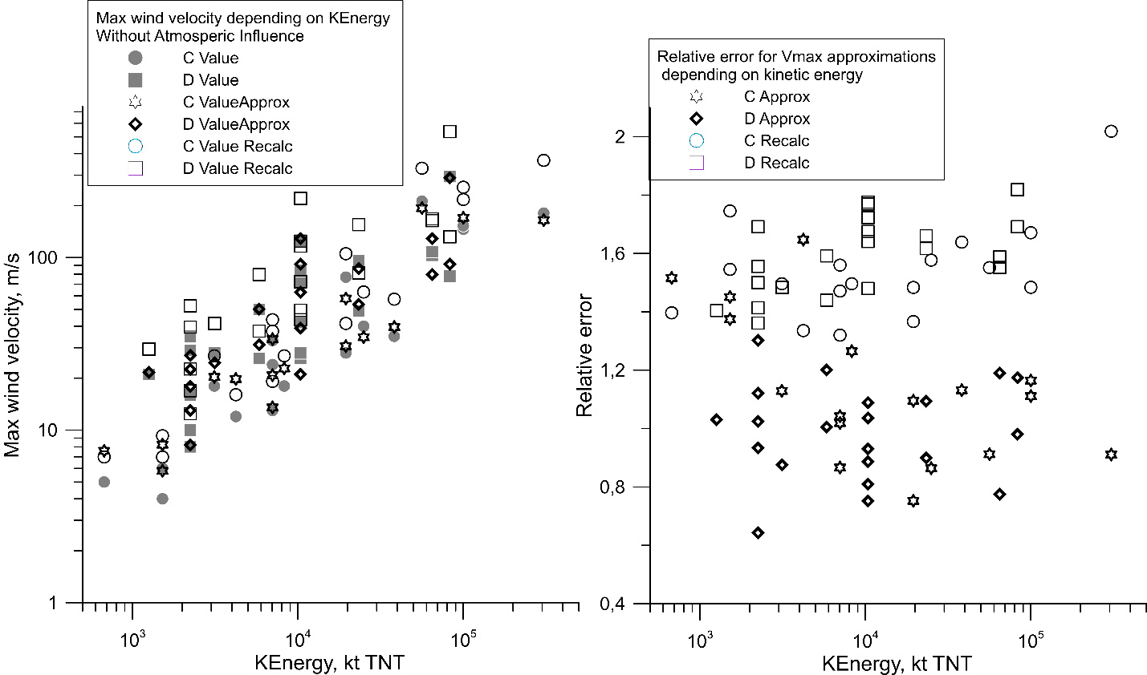
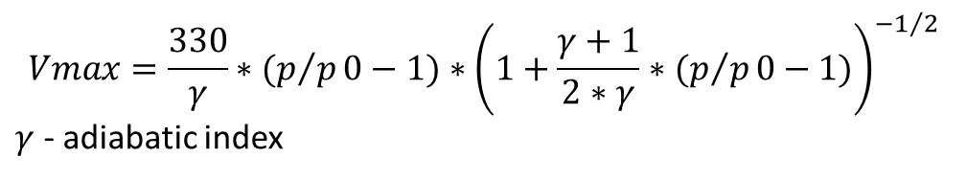
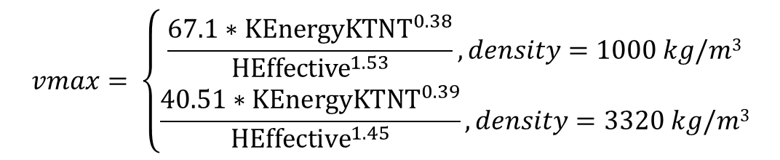
Wind speed
$$Vmax=\frac{330}{γ}∗(p/p0−1)∗{\left(1+\frac{γ+1}{2∗γ}∗(p/p0−1)\right)}^{{−1}/2}$$
$γ$ - adiabatic index
$$vmax= \left\{\begin{aligned}\frac{67.1∗{KEnergyKTNT}^{0.38}}{{HEffective}^{1.53}}, density=1000 kg/m3 \\ \frac{40.51∗{KEnergyKTNT}^{0.39}}{{HEffective}^{1.45}}, density=3320 kg/m3\end{aligned}\right.$$
Comparison approximation results and approximation, recalculated by formula with values of maximal wind velocity.
The Beaufort wind force scale.
Wind Force | Description | Wind speed | Land conditions
8 | Gale | 17.2–20.7 m/s | Twigs break off trees; generally impedes progress
9 | Strong Gale | 20.8–24.4 m/s | Slight structural damage (chimney pots and slates removed).
10 | Storm | 24.5–28.4 m/s | Trees uprooted; considerable structural damage.
11 | Violent Storm | 28.5–32.6 m/s | Accompanied by widespread damage.
12 | Hurricane | ≥ 32.7 m/s | Devastation
https://en.wikipedia.org/wiki/Beaufort_scale
Notes:
Уда́рная адиабата, или адиаба́та Гюгонио́
The level of overpressure and the wind speed behind the shock front are connected through Hugoniot equations

Slide 13
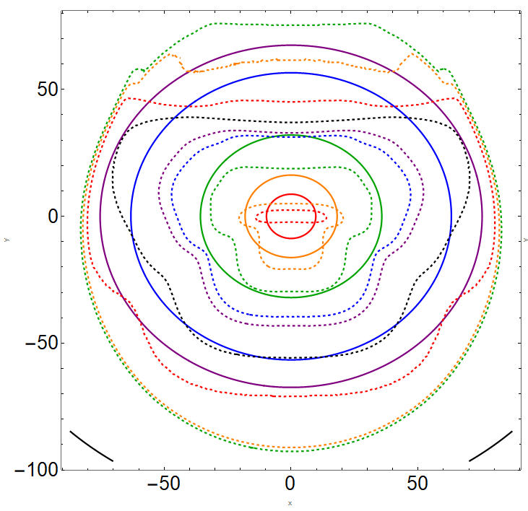
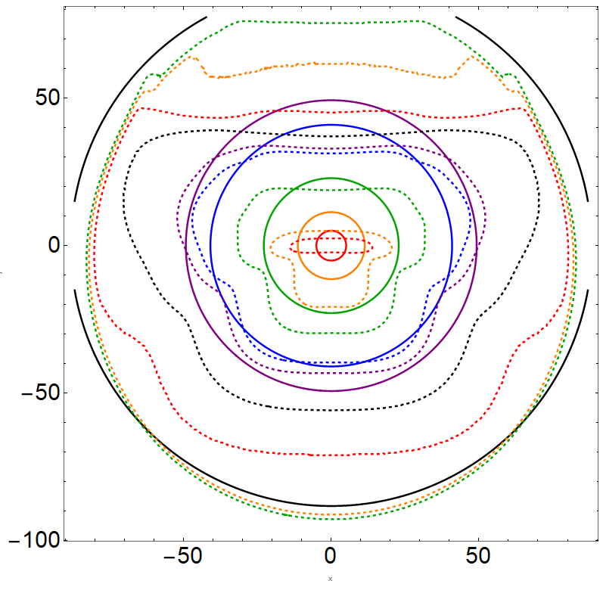
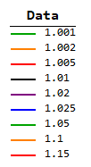
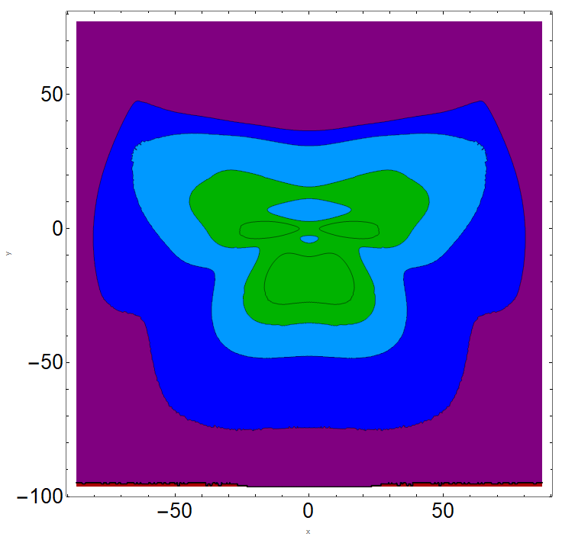
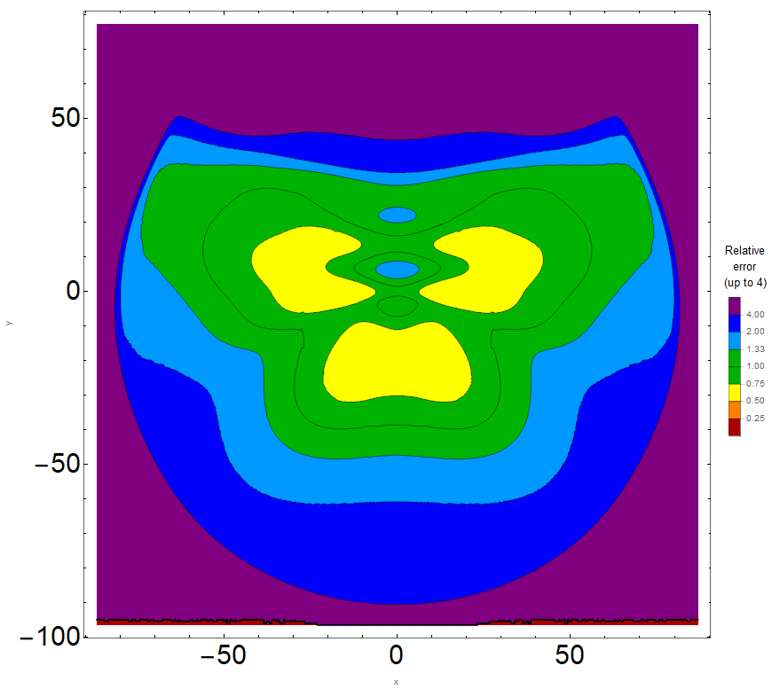

km
km
Results
comparison
Pressure, atm
km
km
Our scaling relations
Collins et al. 2017
D-50-30-11
density: 3320 kg/m³
diameter: 50 m
fall angle: 30°
velocity: 11 km/s²
km
km
km
km

Slide 14
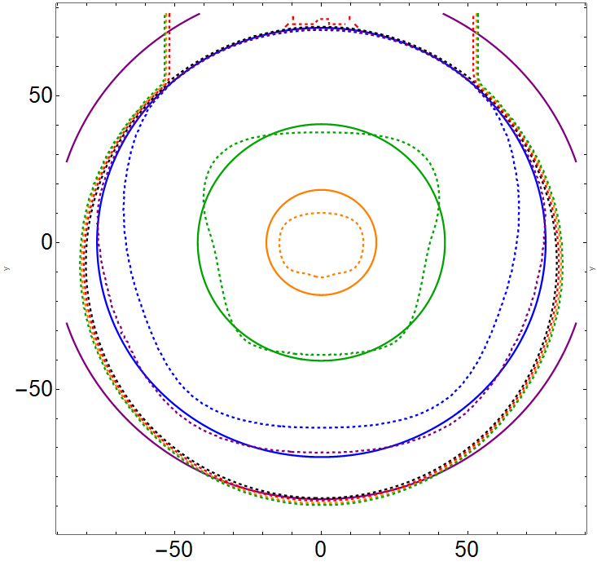
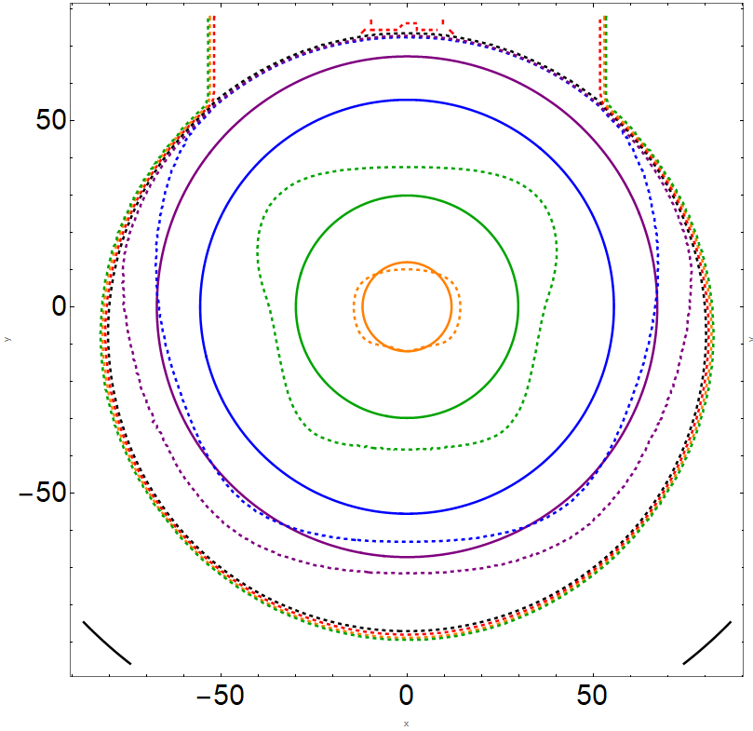

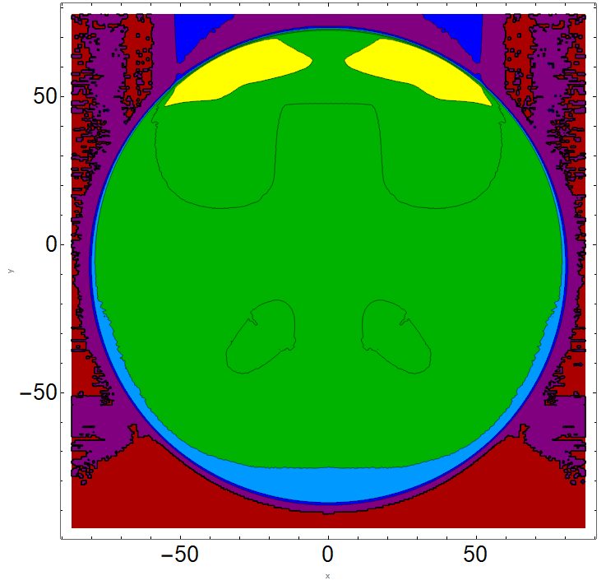
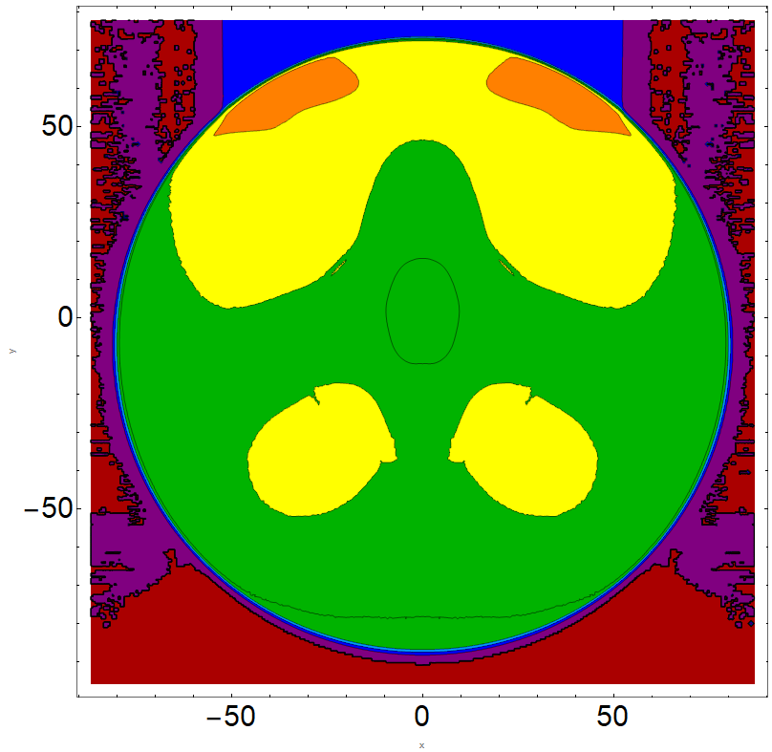
km
km
Results
comparison
Pressure, atm
km
km
Our scaling relations
Collins et al. 2017
C-30-60-70
density: 1000 kg/m³
diameter: 30 m
fall angle: 60°
velocity: 70 km/s²
km
km
km
km

Slide 15
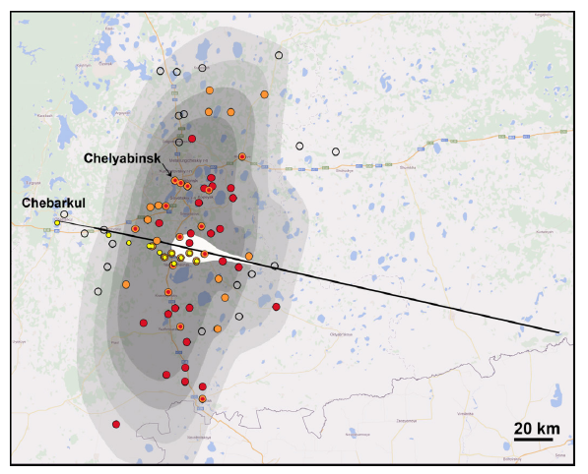
Map of glass damage on the ground
Contours :
(from dark to light)
300 kt Δp>1000 Pa,
520 kt Δp>1000 Pa,
300 kt Δp>500 Pa,
520 kt Δp>500 Pa
The shape of damaged area and blast arrival times
– corresponds to energy deposition along extended part of trajectory
( at H>23 km)
solid orange circles - for reported damage
open black circles - for no damage;
solid red circles the most damaged villages in each district (as reported by the government)..
White - the fireball brightness on a linear scale.
Notes:
With comparison of pressure assessment by light curve and numerous reports from people and official statistics, it gives a good quality
Both assessments in also good agreement with numerous reports from people and official statistics

Slide 16
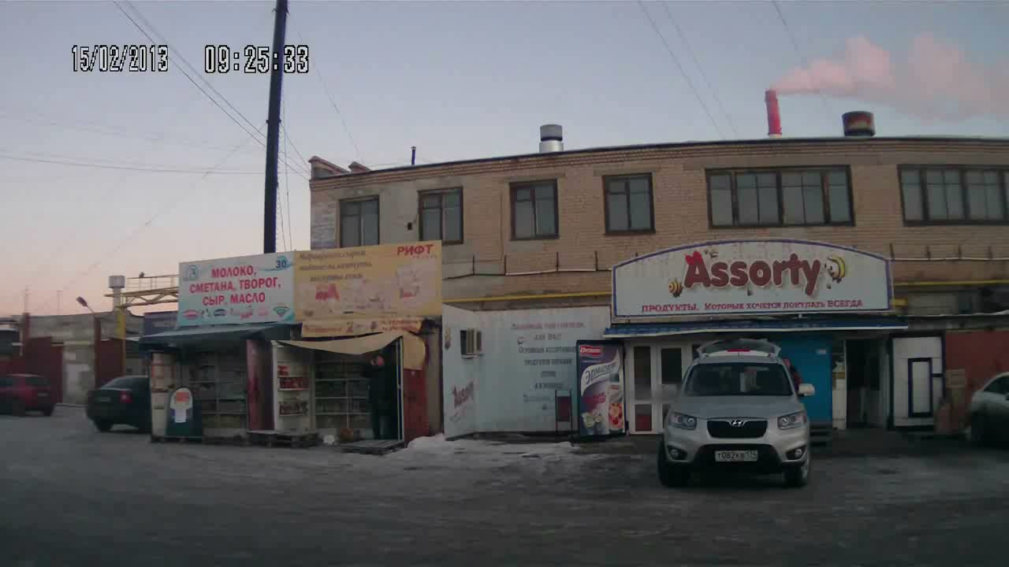

Slide 17
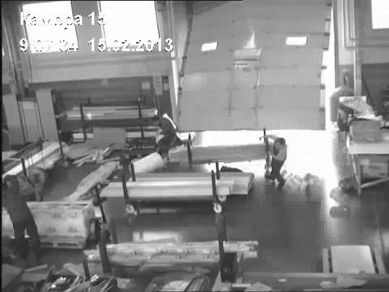
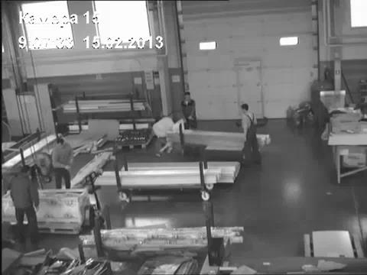
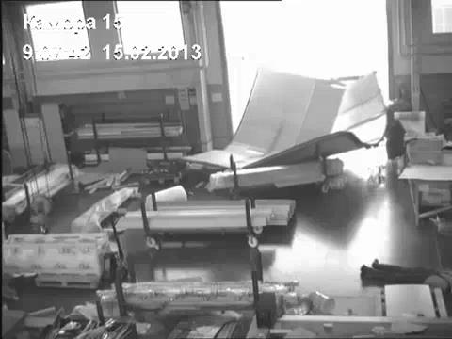
Arrival of shock wave
Injuries - mostly due to flying glass from shattered windows, from walking in and handling glass.
Some injuries - from being hit by objects
112 were hospitalize (39 kids)

Slide 18
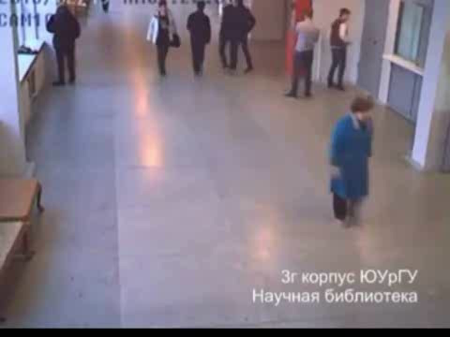

Slide 19
Chelyabinsk airbust event aspects
from eye witness interviews
Locations of the respondents reporting ears injuries; locations of individual respondents from Internet data are grouped and shown in centered circles. Black curves correspond to expected levels of overpressure (labels mark relative overpressure, the level 0.01 correspond to 1 kPa) according the QL model (Shuvalov et al., 2017). Position of main peak on trajectory is marked by line with grey circle MP (shifted to avoid overdrawing). The meteoroid trajectory is shown by a black line.
Kartashova, A.P., Popova, O.P., Glazachev, D.O., Jenniskens, P., Emel'yanenko, V.V., Podobnaya, E.D., Skripnik, A.Y. Study of injuries from the Chelyabinsk airburst event. Planetary and Space Science, 160, 107-114 (2018).
Notes:
Respondents mentioned ear injuries, which included sustained ear pain, deaf ears, tinnitus (ringing), and short-term hearing loss. A total of 89 people (23% of reported injuries/ailments, or 5% of all respondents) complained of temporarily stunned or stuffy ears. There was no report of eardrum rupture, which implies that the overpressure never exceeded 16.5 kPa, the threshold at which the probability of rupture of the tympanic membrane is 1% (Mannan and Lees, 2005).
У 1 из 100 при давлении 16,5 kPa рвется барабанная перепонка
Это 1,16 атм

Slide 20
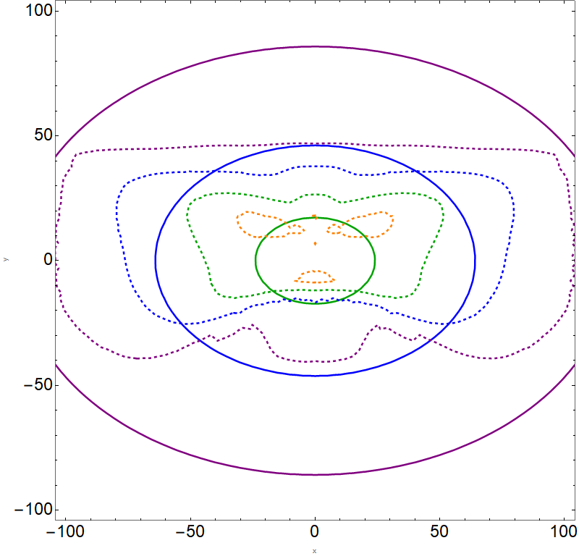
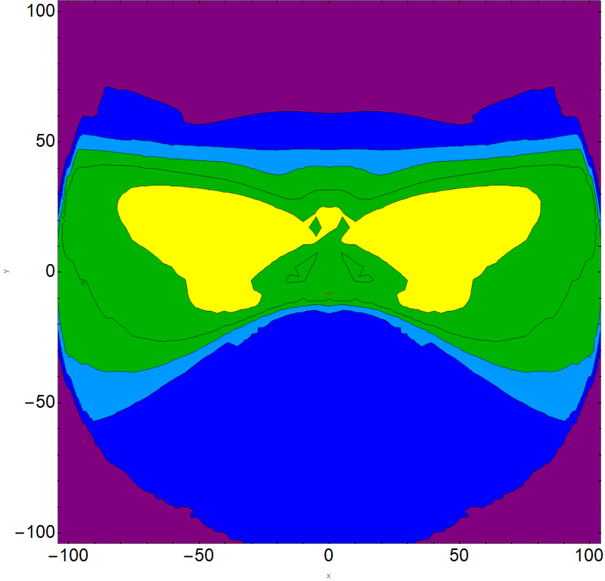


Comparison of modeling and approximations for Chelyabinsk
Contours of overpressure (atm) for modelling Chelyabinsk-like body and scaling relation model
The contours are not stretched enough

Slide 21
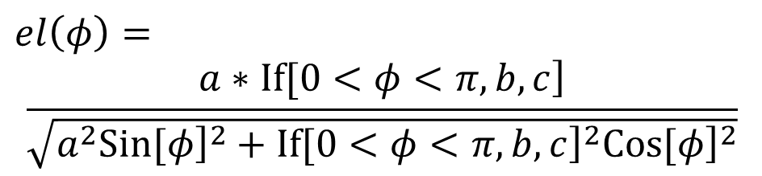
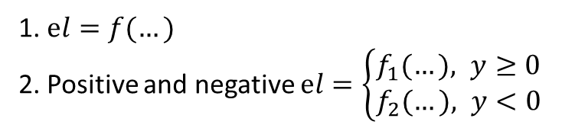
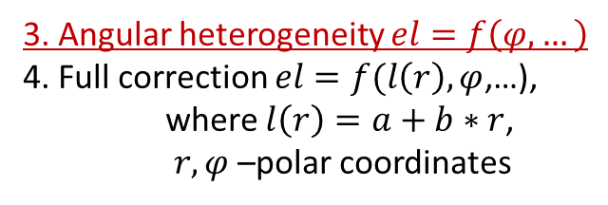
The spatial heterogeneity
1. $el=f(…)$
2. Positive and negative $el=\left\{\begin{aligned}f_{1}(…), y≥0 \\ &f_{2}(…), y<0\end{aligned}\right.$
3. Angular heterogeneity $el=f\left(φ,…\right)$
4. Full correction $el=f(l\left(r\right), φ$,…),
where $l\left(r\right)=a+b∗r$,
$r,φ$ –polar coordinates
“…” – replaces impact parameters – diameter, fall angle, velocity, density, kinetic energy
$$el\left(φ\right)=$$
$$\frac{\left.a∗If[0<φ<π,b,c\right]}{\sqrt{a^{2}{\left.Sin[φ\right]}^{2}+{\left.If[0<φ<π,b,c\right]}^{2}{\left.Cos[φ\right]}^{2}}}$$
two semi-ellipse with params a=1, b=0.5 и c=1.5

Slide 22
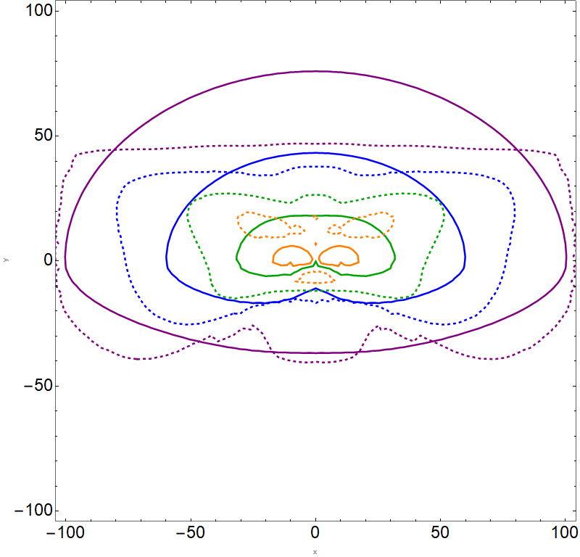
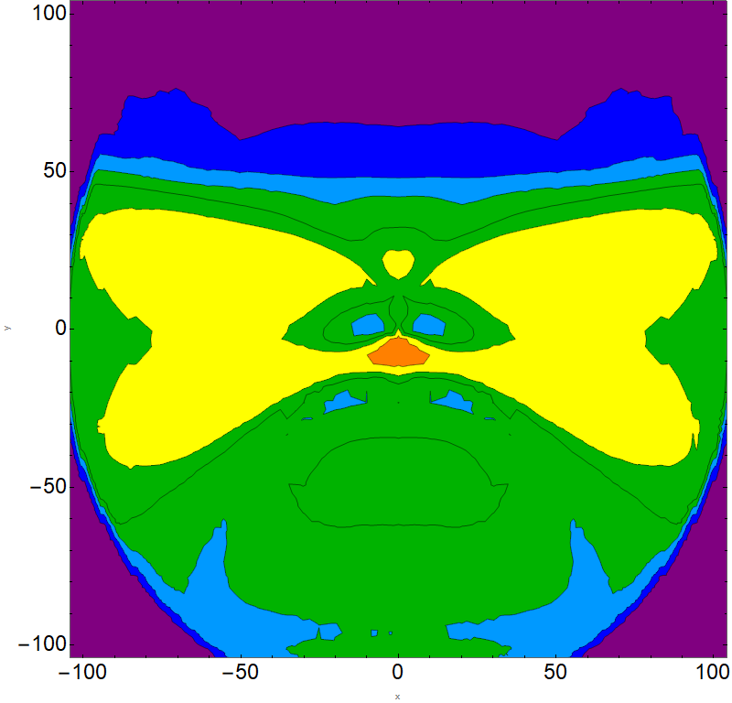
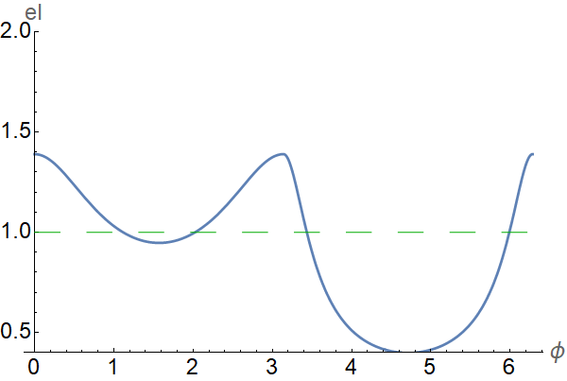
Comparison of modeling and approximations for Chelyabinsk-like
Diameter:20m, entry angle:18⁰, velocity:19 km/s (3-param el)
Contours of overpressure (atm) for modelling Chelyabinsk-like body and scaling relation model

Slide 23
Tunguska eyewitness accounts, injuries, and casualties
Location map of eyewitness reports, with each symbol representing one or more accounts.
Legend: Glass damage (ﬁlled red circle); glass rattled, not broken (o); chum destruction (Λ); heat and unconsciousness (orange X); Reports of people falling (person symbol). Positions of eyewitnesses according to Voznesensky (1925) (=x), Krinov (1966) (=+), Konenkin (1967) (=*), and Vasilyev et al. (1981) (=+). (For interpretation of the references to colour in this ﬁgure legend, the reader is referred to the web version of this article.)
overlain with airburst model (12 Mt, 2000 kg/m3, 25° entry angle, 27 km/s entry speed). Contours correspond to (from dark to light): 1500, 1000, 700 and 500 Pa overpressure.
Jenniskens, P., Popova, O. P., Glazachev, D. O., Podobnaya, E. D., Kartashova, A. P. Tunguska eyewitness accounts, injuries, and casualties. Icarus 327, 4-18 (2019).

Slide 24
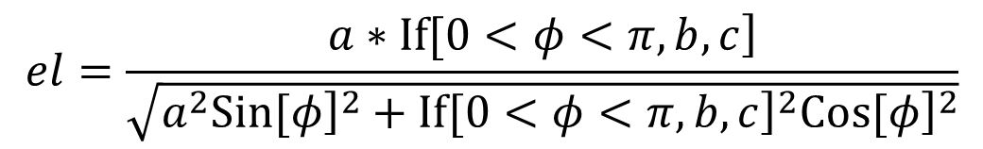
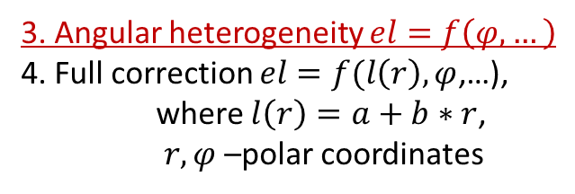








Crater-forming events
$$p/{p0}=1+el∗\frac{f∗{E_{k}}^{1.4/3}}{d^{1.4}}$$
x,y – spatial coordinates
el – ellipticity parameter,
$E_{k}$ – kinetic energy of the impactor in kt TNT,
$H_{eff}$- effective height of point source.
$$d=\sqrt{{\left(x\right.}^{2}+y^{2})}∗{10}^{3}$$
$$f=0.046−0.0004∗\log_{10}{E_{k}}$$
The spatial heterogeneity
$$el=\frac{\left.a∗If[0<φ<π,b,c\right]}{\sqrt{a^{2}{\left.Sin[φ\right]}^{2}+{\left.If[0<φ<π,b,c\right]}^{2}{\left.Cos[φ\right]}^{2}}}$$
1. $el=f(…)$
2. Positive and negative $el=\left\{\begin{aligned}f_{1}(…), y≥0 \\ &f_{2}(…), y<0\end{aligned}\right.$
$$a=\left\{\begin{aligned}&1.1∗{\left(\sin{α}\right)}^{−0.34}, ρ=1000 kg/{m^{3}} \\ &0.56∗{\left(\sin{α}\right)}^{−0.27}, ρ=3320 kg/{m^{3}}\end{aligned}\right.$$
3. Angular heterogeneity $el=f\left(φ,…\right)$
4. Full correction $el=f(l\left(r\right), φ$,…),
where $l\left(r\right)=a+b∗r$,
$r,φ$ –polar coordinates
$$b=\left\{\begin{aligned}&1.7∗{\left(\sin{α}\right)}^{−0.54}, ρ=1000 kg/{m^{3}} \\ &0.84∗{\left(\sin{α}\right)}^{−1.2}, ρ=3320 kg/{m^{3}}\end{aligned}\right.$$
“…” – replaces impact parameters – diameter, fall angle, velocity, density, kinetic energy
$$c=\left\{\begin{aligned}&0.65+0.064∗{\left(\sin{α}\right)}^{−2.8}, ρ=1000 kg/{m^{3}} \\ &0.44+0.0083∗{\left(\sin{α}\right)}^{−3.8}, ρ=3320 kg/{m^{3}}\end{aligned}\right.$$

Slide 25




Comparison of modeling and approximations for
Comet diameter:300m entry angle:60⁰, velocity:20km/s

Slide 26



Comparison of modeling and approximations for
Dunite diameter:1000m entry angle:60⁰, velocity:20km/s

Slide 27


Comparison of modeling and approximations for
Comet diameter:3000m entry angle:60⁰, velocity:20km/s

Slide 28


Slide 29

http://www.AsteroidHazard.pro

Slide 30
Summary
The scaling relations for shock wave effects from large meteoroids decelerated in the Earth’s atmosphere are presented.
For the first time, this scaling relations take into account spatial asymmetry.
The scaling relations for overpressure distribution as well as for the maximal value of the overpressure, and for the areas, where overpressure exceed some levels, are presented
Suggested scaling relations were compared with modelling results and demonstrated reasonable agreement

Slide 31
Thank you for attention
follow the updates on the site
AsteroidHazard.pro

Slide 32

Modeled variants
Square figures - asteroids
Circle figures - comets
Heffective, km
Total 39 variants of different diameter, fall angle, velocity and density
Log(Ek in kt TNT)
Notes:
At the moment we have 39 calculated variants
This is distribution of all variants by its energy and its effective altitude
This altitude is used as zero order for point source.
After that we take into account the spatial heterogeneity

Slide 33



Overpressure at the ground
dE/dz~QL model
dE/dz~light curve
Dark: >2000 Pa
Gray: > 1000 Pa
Light gray:>500 Pa
The calculations was stopped before this area was totally covered
Maximal ∆P~3.3 kPa
Maximal ∆P~4 kPa
Main characteristics of overpressure zones (>1 kPa) (sizes, maximal ∆P) -
satisfactory agreement
between results obtained in the frame of QL model and previous modeling
under assumption that energy deposition is proportional to the light curve
Notes:
With comparison of pressure assessment by light curve and numerous reports from people and official statistics, it gives a good quality
There is pressure distribution assessment by the light curve
And they are in good agreement

Slide 34
Comparison of modeling and approximations
for Chelyabinsk
°
km
km
Contours of overpressure (atm) for modelling Chelyabinsk-like body and scaling relation model
The contours are not stretched enough

Slide 35



$$Q\left(x,y\right)=\frac{η∗E_{k}}{ ({H_{rad}}^{2}+{el∗x}^{2}+y^{2})}$$
$$p/{p0}=1+a∗{\left(\frac{{E_{k}}^{2/3}}{{H_{eff}}^{2}+el∗x^{2}+y^{2}}\right)}^{0.66}$$
$$a=0.2∗\frac{{E_{k}}^{0.035}}{{H_{eff}}^{0.22}}$$
$$\left.el=1−0.02∗{H_{eff}}^{1.16}∗{\left.Cos[α\right]}^{2.7}{Log[E}_{k}\right]$$
$$η=\left\{\begin{aligned}\frac{100∗5.75}{D^{0.96}{E_{k}}^{0.2}Sin[a]}, density=3320 kg/m^{3} \\ \frac{100∗1.019}{D^{0.49}{E_{k}}^{0.13}Sin[a]}, density=1000 kg/m^{3}\end{aligned}\right.$$
$$H_{rad}=\left\{\begin{aligned}3.85+1.05{∗H}_{eff}, density=3320 kg/m^{3} \\ 4.09+0.95{∗H}_{eff}, density=1000 kg/m^{3}\end{aligned}\right.$$

Slide 36



Comparison of modeling and approximations for
Dunite diameter:3000m entry angle:45⁰, velocity:20km/s

Slide 37


Collins et al. (2017)
Earlier, another scaling relations based on the results of nuclear explosions and semi-analytical models of meteoroid`s entry with fragmentation were suggested by (Collins et al., 2005). This model was recently revised in Collins et al. (2017) as the previous version underestimated airbusts overpressures.
$$p\left(r\right)=3.14∗{10}^{11}∗{\left(r^{2}+z_{b}^{2}\right)}^{−\frac{2.6}{2}}+{\left(r^{2}+z_{b}^{2}\right)}^{−\frac{1.13}{2}}$$
Here p is overpressure (Pa), r means radius on the surface in meters and z_{b} is an effective height in meters (the height above the surface, at which the fragmented impactor, which is described in the frame of the pancake model, increases its diameter by a factor of ~7, all the impact energy is assumed to be deposited at this altitude), both normalized on E_{kt}^{1/3}.
The pressure p/p0 distribution for a 50-m-diameter cometary body entering with a velocity of 70 km/s at 30°. The trajectory is along the X-axis from right to left.
Left: Curves drawn by dashed lines with grey labels refer to results of numerical simulations; solid curves with bold labels denote a distribution of relative pressure from model (Equation 6).
Right: Relative error distributions between numerical simulations and by Collins et al. (2017) approximations.

