Slide 1
STUDY OF GEOHAZARD STATE OF KADJI-SAI URANIUM TAILING SITE
Institute of Geosphere Dynamics of Russian Academy of Sciences
5th International Conference
Trigger Effects in Geosystems, Moscow
Zheenbek Kulenbekov
Sagynbek Orunbaev
4—7 June, 2019
Moscow

Slide 2
Contents
Introduction: Radioactive waste and tailings of the former Kadji-Sai uranium mine.
Remote sensing of tailings. High resolution panchromatic SPOT images.
Seismicity of the region (historical seismicity) serve as a high potential risk to the tailings
Slope stability (generally steep relief) of the area
Strong seismic shaking might destabilize large surface soil masses like landslides, avalanches.

Slide 3
INTRODUCTION
The deposited total amount of brown coal is approximately 4x10⁶ tons with an estimated content of 0.25% to 0.35% uranium.
Coal was combusted in a thermal plant, and then uranium oxide was separated from the ashes by flotation, packed and transported to a plant for further processing (Gavshin et al. 2004)
Nowadays, a radioactive coal ash volume is about 150 to 400 x 10³ m³
In 2004 the geological engineering investigation of the Kadji-Sai Uranium Tailing Site was performed by the MESKR
There is still uncontrolled public access to hazardous sites
The Kadji-Sai uranium tailing site is hazardous due to radioactive and toxic elements in the deposits
Sudden or continuous release of contaminants may have a substantial impact on the environment

Slide 4
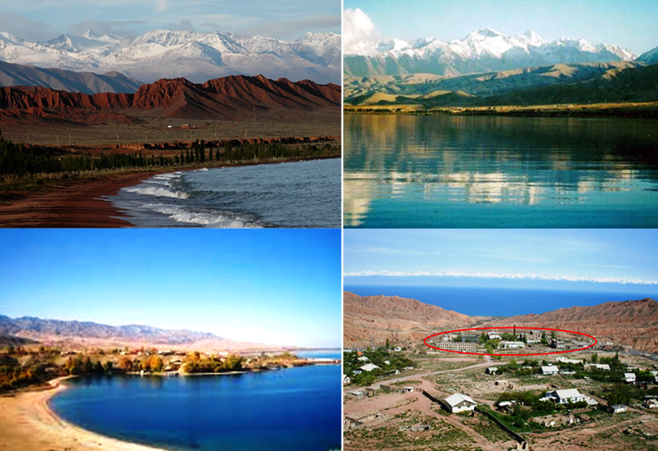

Slide 5
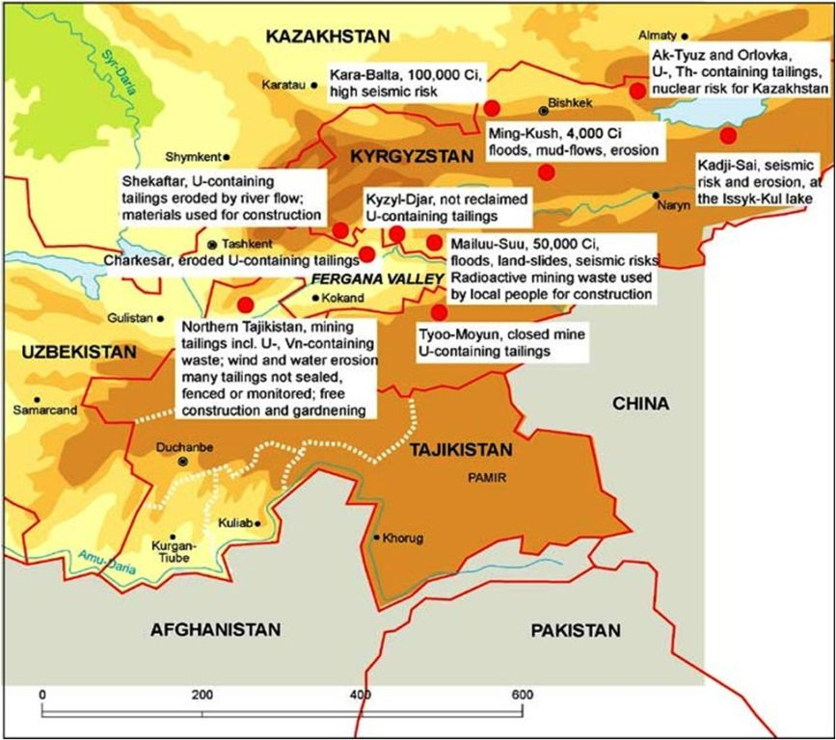
GENERAL STATE OF THE PROBLEM
(UNEP, GRID ARENDAL. 1997)

Slide 6
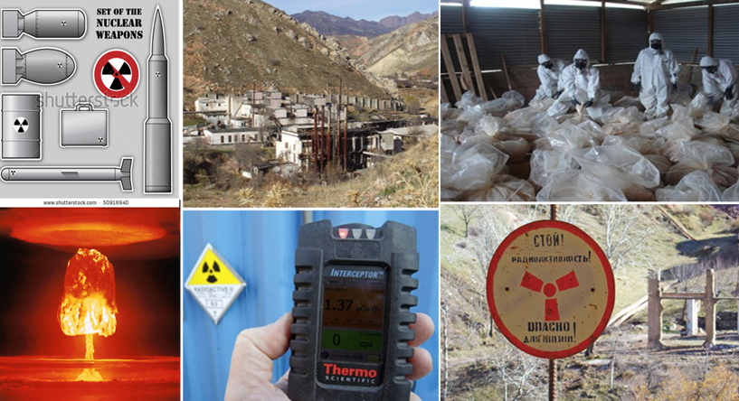
Sources ?

Slide 7
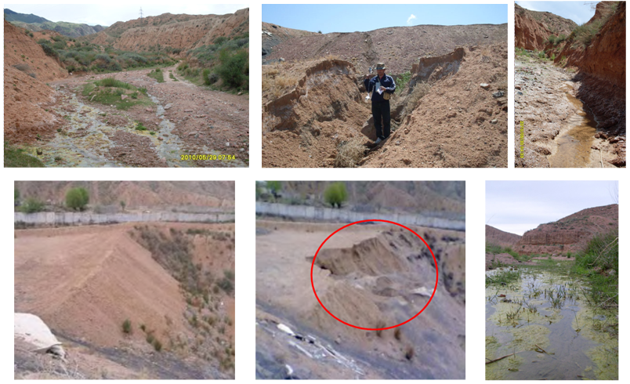
STUDY OF GEOHAZARD STATE OF KADJI-SAI URANIUM TAILING SITE, Kyrgyzstan
Voitsekhovich,.2008 and Kulenbekov, 2010

Slide 8
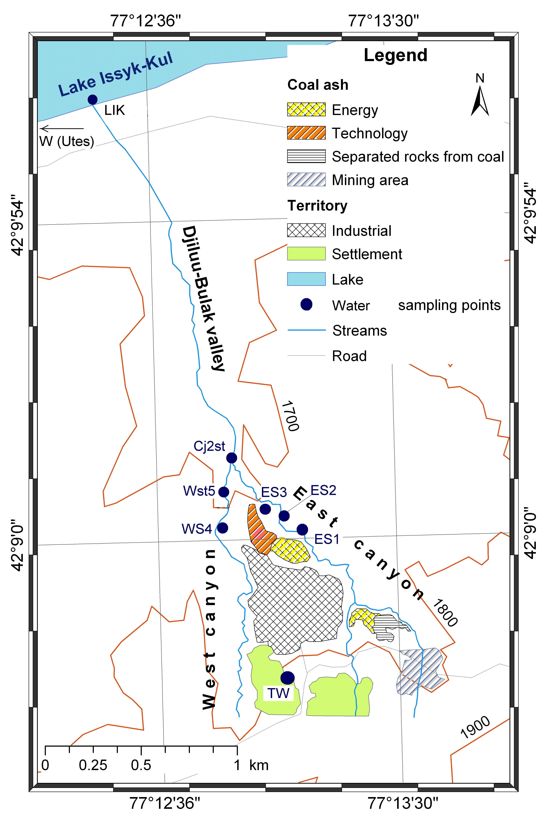
Objective
Study of geohazards with aim high seismicity and erosion issues on the tailing site using remote sensing data
Image processing and modeling
Panchrommatic SPOT images were processed using ENVI and ArcGIS software

Slide 9
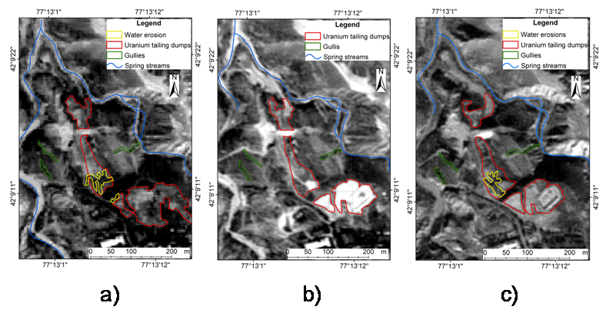
Weathering issues
Weathering processes on Kadji-Sai uranium tailing dumps. Time series of panchromatic SPOT images (with 2.5 m resolution) for a) 2003, b) 2005, c) 2007 are shown here. (Datum: WGS 1984)

Slide 10
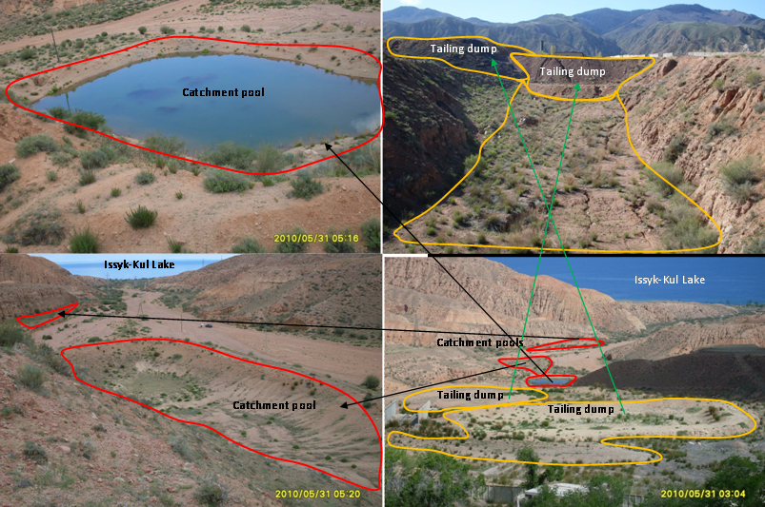
Erosion is probably the biggest risk for this site due to it is position between two perennial creeks
Using high resolution panchromatic SPOT images is one of the advanced methods to analyze erosion issues

Slide 11
Scientific goal of the recommendation is to:
Forecasting possible future environmental damage at Kadji-Sai uranium tailing site by the uranium tailing on this site
Government of Kyrgyz Republic should take into account to undertake the following operations:
The reconstruct off-take channels and guarding fences around tailings as well as install safety signs and symbols nearby tailings
Government of Kyrgyz Republic should take into account possibilities to accomplish the following measures in terms of a state policy:
to provide a forum for complex state decision making regarding ecological issues in the Issyk-Kul region and their solutions

Slide 12
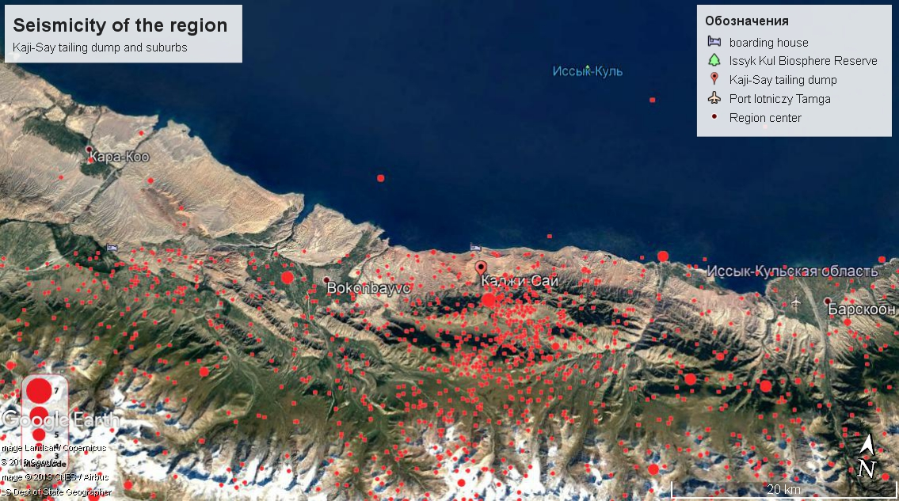

Slide 13
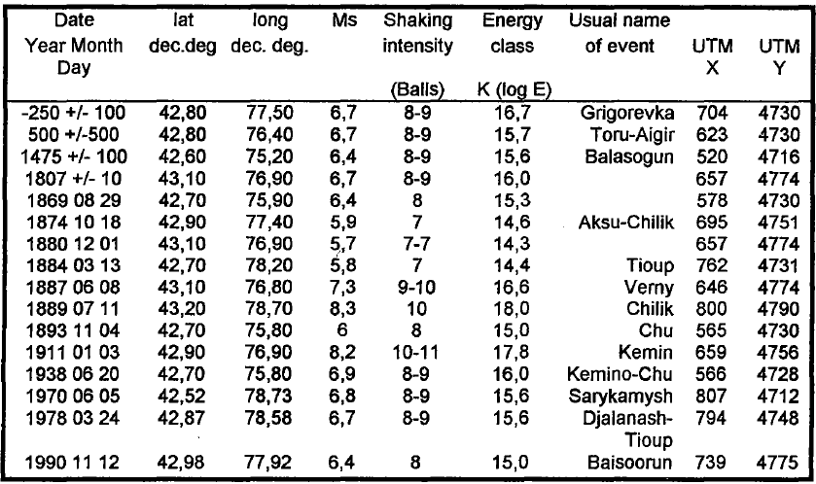
Strong earthquakes of Issyk-Kul basin and surrounding areas

Slide 14
Moderate earthquakes of Issyk-Kul basin and surrounding areas
# | Event ID | Date | Time | lat: | lat: | depth | Azim gap | M, mb
1 | 612718993 | 2018-09-14 | 22:15:05 | 41.94 | 77.21 | 19 | 76 | 4.5
2 | 611833675 | 2017-04-28 | 05:01:24 | 41.89 | 76.81 | 6 | 61 | 4.7
3 | 605658462 | 2014-11-14 | 01:24:16 | 42.11 | 77.19 | 12 | 12 | 5.5
4 | 13794392 | 2009-09-24 | 07:57:13 | 42.07 | 77.52 | 32 | 27 | 4.7
5 | 8079884 | 2006-02-05 | 10:28:10 | 41.88 | 77.05 | 0 | 61 | 4.5
6 | 10599274 | 2006-03-07 | 20:34:10 | 41.85 | 77.28 | 2 | 52 | 4.2
7 | 1738852 | 2000-08-08 | 01:15:09 | 42.11 | 76.94 | 33 | 27 | 5.2
8 | 942875 | 1996-01-18 | 09:33:49 | 41.84 | 77.50 | 16 | 25 | 5.2
9 | 563404 | 1983-12-21 | 19:30:59 | 42.06 | 77.43 | 23 | 23 | 4.8
10 | 641214 | 1980-07-05 | 20:25:25 | 41.90 | 77.45 | 11 | 14 | 5.4
11 | 666211 | 1979-04-06 | 18:30:06 | 41.91 | 77.53 | 8 | 19 | 5.1
12 | 761557 | 1973-04-14 | 19:49:45 | 41.85 | 77.57 | 11 | 71 | 4.7
13 | 770825 | 1972-08-22 | 16:35:05 | 42.18 | 77.40 | 11 | 70 | 4.9
14 | 853212 | 1965-10-18 | 10:21:46 | 41.95 | 77.51 | 11 | 32 | 5.1

Slide 15
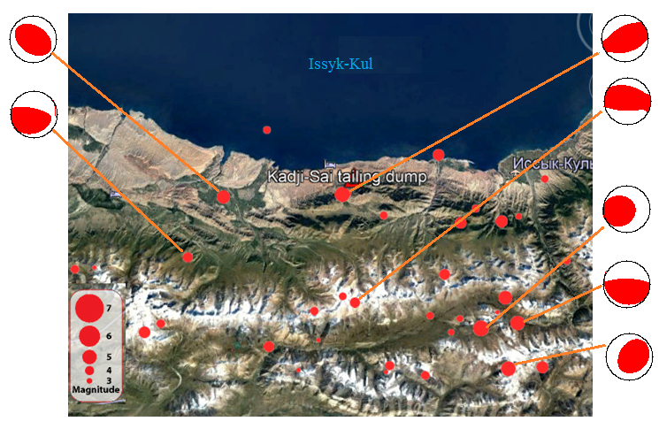
Basic fault system in Issyk-Kul basin
The map of moderate (mb=3.5–5.5) earthquakes with focal mechanism.

Slide 16
The potential contaminated areas in case of the tailings break off according to (Kyrgyzstan Uranium Tailings, 2008).
Kyrgyzstan Uranium Tailings, 2008

Slide 17
Conclusions
Radioactive waste and tailings of the former Kadji-Sai uranium mine and treatment plant in north eastern Kyrgyzstan are in high environmental concern.
High resolution panchromatic SPOT images is one of the good way to use for erosion study of tailing site.
Historical seismicity of the region serve as a high potential risk to the dumpsites (Around Kadji-Sai, earthquakes with magnitude at mb =4.0-5.5, and intensity equivalent to I=6.0-7.0 (balls) periodically took place in a region)
The area is characterized by critical slope stability due to generally steep relief.
Therefore strong seismic shaking can easily destabilize large surface soil masses and cause numerous gravity mass movements like landslides, avalanches.

Slide 18
Thank you for your attention!

